Slide 1



Slide 2



Venture capital means funds made available for startup firms and small businesses with exceptional growth potential.
Venture capital is money provided by professionals who alongside management invest in young, rapidly growing companies that have the potential to develop into significant economic contributors.

Slide 3
Venture Capitalists generally:
Finance new and rapidly growing companies
Purchase equity securities
Assist in the development of new products or services
Add value to the company through active participation.

Slide 4
The SEBI has defined Venture Capital Fund in its Regulation 1996 as ‘a fund established in the form of a company or trust which raises money through loans, donations, issue of securities or units as the case may be and makes or proposes to make investments in accordance with the regulations’.

Slide 5


Long time horizon
Lack of liquidity
High risk
Equity participation
Participation in management

Slide 6

It injects long term equity finance which provides a solid capital base for future growth.
The venture capitalist is a business partner, sharing both the risks and rewards. Venture capitalists are rewarded by business success and the capital gain.
The venture capitalist is able to provide practical advice and assistance to the company based on past experience with other companies which were in similar situations.

Slide 7

The venture capitalist also has a network of contacts in many areas that can add value to the company.
The venture capitalist may be capable of providing additional rounds of funding should it be required to finance growth.
Venture capitalists are experienced in the process of preparing a company for an initial public offering (IPO) of its shares onto the stock exchanges or overseas stock exchange such as NASDAQ.
They can also facilitate a trade sale.

Slide 8

1. Seed Money:
Low level financing needed to prove a new idea.
2. Start-up:
Early stage firms that need funding for expenses associated with marketing and product development.
3. First-Round:
Early sales and manufacturing funds.
4. Second-Round:
Working capital for early stage companies that are selling product, but not yet turning a profit .

Slide 9
5. Third-Round:
Also called Mezzanine financing, this is expansion money for a newly profitable company
6. Fourth-Round:
Also called bridge financing, it is intended to finance the "going public" process

Slide 10


Financial Stage | Period (Funds locked in years) | Risk Perception | Activity to be financed
Seed Money | 7-10 | Extreme | For supporting a concept or idea or R&D for product development
Start Up | 5-9 | Very High | Initializing operations or developing prototypes
First Stage | 3-7 | High | Start commercials production and marketing

Slide 11
Financial Stage | Period (Funds locked in years) | Risk Perception | Activity to be financed
Second Stage | 3-5 | Sufficiently high | Expand market and growing working capital need
Third Stage | 1-3 | Medium | Market expansion, acquisition & product development for profit making company
Fourth Stage | 1-3 | Low | Facilitating public issue

Slide 12
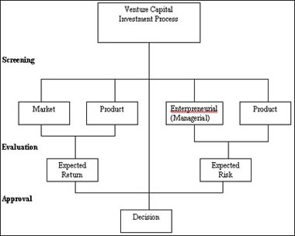

Slide 13

Deal origination
Screening
Due diligence (Evaluation)
Deal structuring
Post investment activity
Exit plan

Slide 14
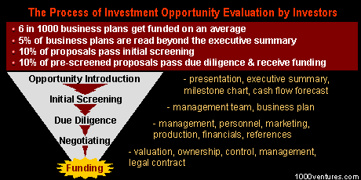

Slide 15


The financing pattern of the deal is the most important element. Following are the various methods of venture financing:
Equity
Conditional loan
Income note
Participating debentures
Quasi equity

Slide 16


Initial public offer(IPOs)
Trade sale
Promoter buy back
Acquisition by another company

Slide 17




Slide 18

The concept of venture capital was formally introduced in India in 1987 by IDBI.
The government levied a 5 per cent cess on all know-how import payments to create the venture fund.
ICICI started VC activity in the same year
Later on ICICI floated a separate VC
company - TDICI

Slide 19

VCFs in India can be categorized into following five groups:
Those promoted by the Central Government controlled development finance institutions. For example:
- ICICI Venture Funds Ltd.
- IFCI Venture Capital Funds Ltd (IVCF)
- SIDBI Venture Capital Ltd (SVCL)

Slide 20
2) Those promoted by State Government controlled development finance institutions.
For example:
- Punjab Infotech Venture Fund
- Gujarat Venture Finance Ltd (GVFL)
- Kerala Venture Capital Fund Pvt Ltd.
3) Those promoted by public banks.
For example:
- Canbank Venture Capital Fund
- SBI Capital Market Ltd

Slide 21
4)Those promoted by private sector
companies.
For example:
- IL&FS Trust Company Ltd
- Infinity Venture India Fund
5)Those established as an overseas venture capital fund.
For example:
- Walden International Investment Group
- HSBC Private Equity
management Mauritius Ltd

Slide 22

AS PER SEBI
AS PER INCOME TAX ACT,1961

Slide 23

VCF are regulated by the SEBI (Venture Capital Fund) Regulations, 1996.
The following are the various provisions:
A venture capital fund may be set up by a company or a trust, after a certificate of registration is granted by SEBI on an application made to it. On receipt of the certificate of registration, it shall be binding on the venture capital fund to abide by the provisions of the SEBI Act, 1992.

Slide 24

A VCF may raise money from any investor, Indian, Non-resident Indian or foreign, provided the money accepted from any investor is not less than Rs 5 lakhs. The VCF shall not issue any document or advertisement inviting offers from the public for subscription of its security or units

Slide 25


SEBI regulations permit investment by venture capital funds in equity or equity related instruments of unlisted companies and also in financially weak and sick industries whose shares are listed or unlisted

Slide 26
At least 80% of the funds should be invested in venture capital companies and no other limits are prescribed.
SEBI Regulations do not provide for any sectoral restrictions for investment except investment in companies engaged in financial services.

Slide 27
A VCF is not permitted to invest in the equity shares of any company or institutions providing financial services.
The securities or units issued by a venture capital fund shall not be listed on any recognized stock exchange till the expiry of 4 years from the date of issuance .

Slide 28
A Scheme of VCF set up as a trust shall be wound up
(a) when the period of the scheme if any, is over
(b) If the trustee are of the opinion that the winding up shall be in the interest of the investors
(c) 75% of the investors in the scheme pass a resolution for winding up or,
(d) If SEBI so directs in the interest of the investors.

Slide 29

The Income Tax Act provides tax exemptions to the VCFs under Section 10(23FA) subject to compliance with Income Tax Rules.
Restrict the investment by VCFs only in the equity of unlisted companies.
VCFs are required to hold investment for a minimum period of 3 years.

Slide 30

The Income Tax Rule until now provided that VCF shall invest only upto 40% of the paid-up capital of VCU and also not beyond 20% of the corpus of the VCF.
After amendment VCF shall invest only upto 25% of the corpus of the venture capital fund in a single company.
There are sectoral restrictions under the Income Tax Guidelines which provide that a VCF can make investment only in specified companies.

Slide 31

It was established in 1993 and is based in Delhi, the capital of India
It is a member based national organization that
- represents venture capital and private equity firms
- promotes the industry within India and throughout the world
- encourages investment in high growth companies and
- supports entrepreneurial activity and innovation.

Slide 32
IVCA members comprise venture capital firms, institutional investors, banks, incubators, angel groups, corporate advisors, accountants, lawyers, government bodies, academic institutions and other service providers to the venture capital and private equity industry.
Members represent most of the active venture capital and private equity firms in India. These firms provide capital for seed ventures, early stage companies and later stage expansion.

Slide 33

Venture capital firms typically source the majority of their funding from large investment institutions.
Investment institutions expect very high ROI
VC’s invest in companies with high potential where they are able to exit through either an IPO or a merger/acquisition.
Their primary ROI comes from capital gains although they also receive some return through dividend.

Slide 34

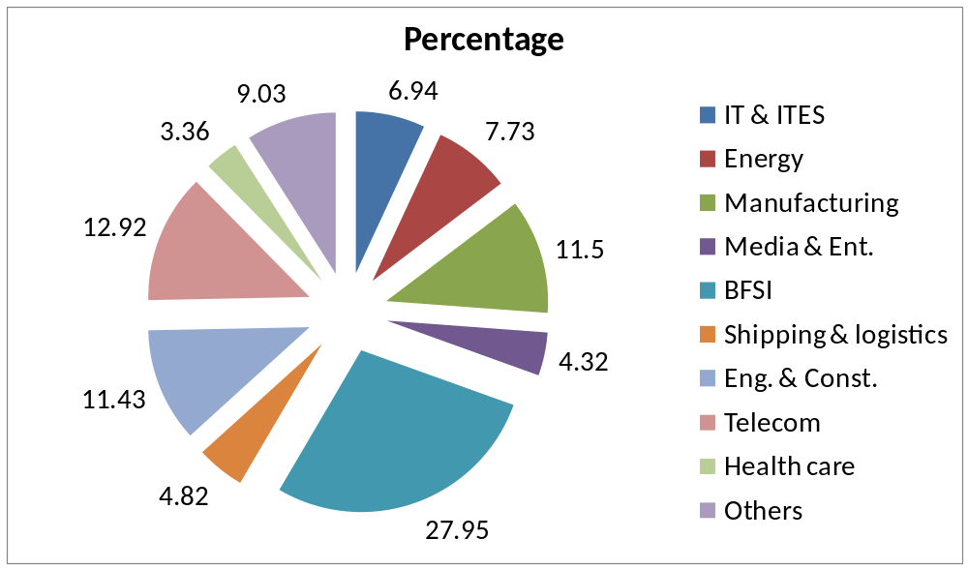
Percentage calculated on the total VC investment- 14,234 USB (fig. of 2007)

Slide 35

CITIES | SECTORS
MUMBAI | Software services, BPO, Media, Computer graphics, Animations, Finance & Banking
BANGALORE | All IP led companies, IT & ITES, Bio-technology
DELHI | Software services, ITES , Telecom
CHENNAI | IT , Telecom
HYDERABAD | IT & ITES, Pharmaceuticals
PUNE | Bio-technology, IT , BPO

Slide 36

The regulatory, tax and legal environment should play an enabling role as internationally venture funds have evolved in an atmosphere of structural flexibility, fiscal neutrality and operational adaptability.
Resource raising, investment, management and exit should be as simple and flexible as needed and driven by global trends.
Venture capital should become an institutionalized industry that protects investors and investee firms, operating in an environment suitable for raising the large amounts of risk capital needed and for spurring innovation through start-up firms in a wide range of high growth areas.

Slide 37
In view of increasing global integration and mobility of capital it is important that Indian venture capital funds as well as venture finance enterprises are able to have global exposure and investment opportunities
Infrastructure in the form of incubators and R&D need to be promoted using government support and private management as has successfully been done by countries such as the US, Israel and Taiwan. This is necessary for faster conversion of R&D and technological innovation into commercial products.

Slide 38

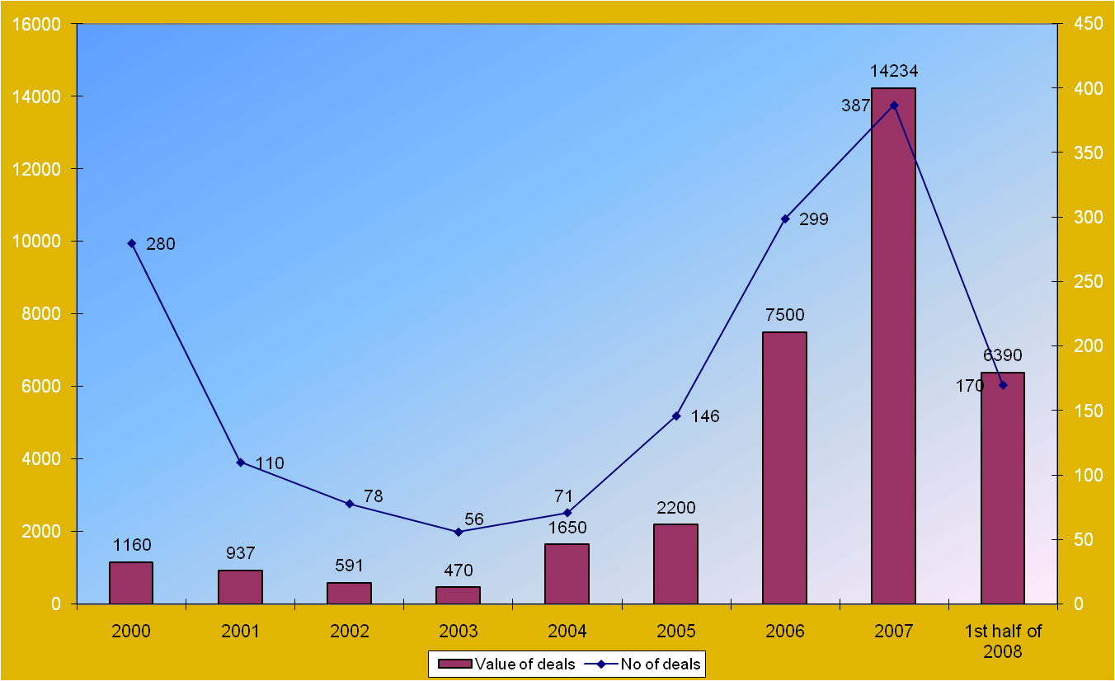

Slide 39

The down market virtually closed the IPO market for emerging companies.
With less opportunities for getting ROI investors tend to scale back, adjust their investment focus and/or get more picky in funding companies.
The investors that put money into their funds became less aggressive during recession so it was harder for the VCs to raise money.

Slide 40

Venture capital (VC) and private equity (PE) funds are likely to take up to two years to regain their 2005-07 level.
With India’s economy bouncing back and the country on track to achieve an 9 % GDP growth, interest in the Indian market is re-emerging.
The VC/PE fund inflow into the country in the last five and half years has been to the tune of over $44.8 billion with investments flowing into around 13,000 domestic companies.
The market regulator, SEBI, has to start looking at a different regulatory framework for this kind of capital, which is essentially risk capital

Slide 41

The increase in weighted deduction of in house R&D will boost up investment in health care.
46% of the total investment is going to infrastructure development which is a positive sign for investors.

Slide 42

VC can help in the rehabilitation of sick units.
VC can assist small ancillary units to upgrade their technologies
VCFs can play a significant role in developing countries in the service sector including tourism, publishing, health care etc.
They can provide financial assistance to people coming out of universities, technical institutes, etc thus promoting entrepreneurial spirits

Slide 43

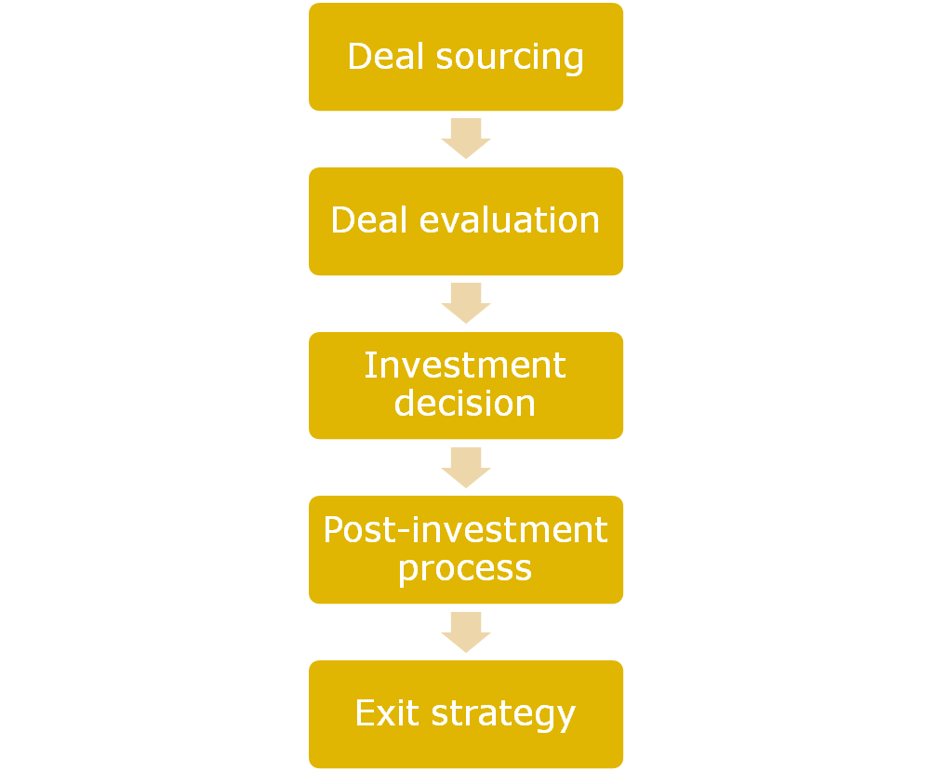

Slide 44
By sectors
  Banking & financial services
  Customer services
  Energy
  Engineering
  Hospitality
  Internet
  IT/ITES
  Logistics
  Manufacturing
  Retail
  Textiles

Slide 45


